Slide 1
Multi-threading

Slide 2
Goals
To understand how multiple threads can execute in parallel
To learn how to implement threads
To understand race conditions and deadlocks
To be able to avoid corruption of shared objects by using locks and conditions
To be able to use threads for a variety of programming problems

Slide 3
Threads
A thread is a program unit that is executed independently of other parts of the program
Types of Threads
  User-level Threads
    Share the same address space
    Created by the application
    Efficient context switch
    Require their own scheduler in the application
    No separate PIDs
  Kernel-level processes
    Created by the OS
    Scheduled by the OS
    Context switch is more expensive and requires hardware support
    Have their own unique PIDs

Slide 4
Thread models
There are three possible thread models pertaining to user threads and operating system processes:
  Many user threads map to a single kernel thread (N:1)
  Each user thread maps to its own kernel thread (1:1)
  User threads map to a smaller number of kernel threads (M:N)
The Java specification can be met with any of these models …

Slide 5
The models …
Application 1
Application 2
Application 3
Application
Level
OS Kernel
Level
(N:1)
(1:1)
(M:N)

Slide 6
Tradeoffs among the models
Many user threads map to a single kernel thread
  Benefits
    Simple
    Low overhead to switch contexts
  Drawbacks
    If a single thread blocks, the entire process blocks (typically)
    Only one thread can access the kernel at a time, so multiple threads cannot run well in parallel on multi-core systems

Slide 7
Tradeoffs among the models
Each user thread maps to its own kernel thread
  Benefits
    If an individual thread blocks, others can keep going
    No need for two-tiered scheduling
    Modern optimization of context switch lessens performance penalties
  Drawbacks
    Potential limits on the total number of threads that can be created
    Uses more memory for separate address spaces

Slide 8
Tradeoffs among the models
User threads map to a smaller number of kernel threads (M:N)
  Benefits
    If an individual thread blocks, others (running in other processes) can keep going
    Less likely to have constraints on the number of threads that can be created compared to the 1:1 model
  Drawbacks
    Complex two-tiered scheduling

Slide 9
Creating a Thread
Define a class that implements the <<Runnable>> interface*
Place the starting code for your task that will execute in a separate Thread into the run() method of your class
Create an instance of your <<Runnable>> class
Construct a Thread instance from the runnable instance.
Call the start() method to start the thread.
* One way to do it – you can also extend Thread

Slide 10
Example
GreetingRunnable.java
A program to print a time stamp and "Hello World" once a second for ten seconds:
Thu Dec 28 23:12:03 PST 2004 Hello, World!
Thu Dec 28 23:12:04 PST 2004 Hello, World!
Thu Dec 28 23:12:05 PST 2004 Hello, World!
Thu Dec 28 23:12:06 PST 2004 Hello, World!
Thu Dec 28 23:12:07 PST 2004 Hello, World!
Thu Dec 28 23:12:08 PST 2004 Hello, World!
Thu Dec 28 23:12:09 PST 2004 Hello, World!
Thu Dec 28 23:12:10 PST 2004 Hello, World!
Thu Dec 28 23:12:11 PST 2004 Hello, World!
Thu Dec 28 23:12:12 PST 2004 Hello, World!

Slide 11
Running Threads
sleep() puts the current thread to sleep for a given number of milliseconds
When a thread is interrupted, a typical action is to terminate the run() method
Thread.sleep(milliseconds)

Slide 12
Thread Scheduler
The thread scheduler runs each thread for a short amount of time (a time slice)
Then the scheduler activates another thread
There will always be slight variations in running times especially when calling operating system services (e.g. input and output)
There is no guarantee about the order in which threads are executed

Slide 13
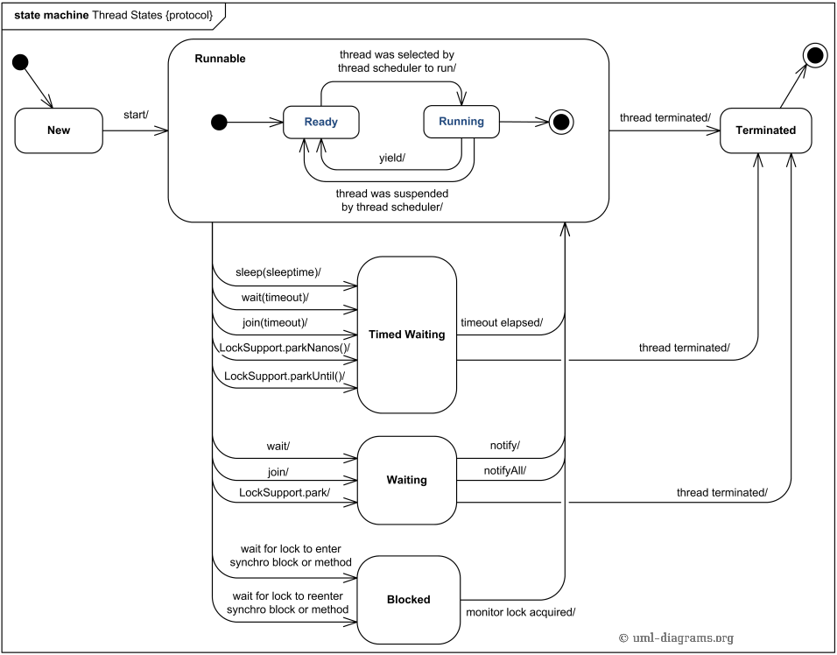

Slide 14
Terminating Threads
A thread terminates when its run method
terminates
Generally speaking, do not terminate a thread using the
deprecated stop() method (deprecated Thread methods)
Instead, notify a thread that it should terminate
interrupt() does not cause the thread to terminate–it sets a boolean field in the thread data structure and may be used to terminate the thread
ThreadInterruptExample.java
t.interrupt();

Slide 15
Terminating Threads
The run method should check occasionally whether it has been interrupted
  Use the interrupted method
  An interrupted thread should release resources, clean up, and exit
  The key is to make sure that data structures have been properly updated

Slide 16
Terminating Threads
The sleep method throws an InterruptedException when a sleeping thread is interrupted
  Catch the exception
  Terminate the thread

Slide 17
Terminating Threads
public void run()
{
try
{
while(true)
// do work
}
catch(InterruptedException e)
{
//clean up
}
}

Slide 18
Terminating Threads
Java does not force a thread to terminate when it is interrupted
It is entirely up to the programmer of the thread what it does when it is interrupted
Interrupting is a general mechanism for getting the thread's attention

Slide 19
Race Conditions
When threads share a common object, they can conflict with each other
Sample program: multiple threads manipulate a bank account
  H:\...\DepositRunnable
  H:\...\WithdrawRunnable

Slide 20
The Sample Application
Creates a BankAccount object
Creates two threads:
  t1 deposits $100 into the bank account for 10 iterations
  t2 withdraws $100 from the bank account for 10 iterations

Slide 21
Scenario to Explain Non-zero Result: Race Condition
The first thread t1 executes the lines
The balance field is still 0, and the
newBalance local variable is 100
t1 reaches the end of its time slice and
t2 gains control
System.out.print("Depositing " + amount);
double newBalance = balance + amount;

Slide 22
Scenario to Explain Non-zero Result: Race Condition
t2 calls the withdraw method which
withdraws $100 from the balance variable;
it is now -100
t2 goes to sleep
t1 regains control and picks up where it left
off; it executes:
The balance is now 100 instead of 0 because
the deposit method used the OLD balance
System.out.println(", new balance is " + newBalance);
balance = newBalance;

Slide 23
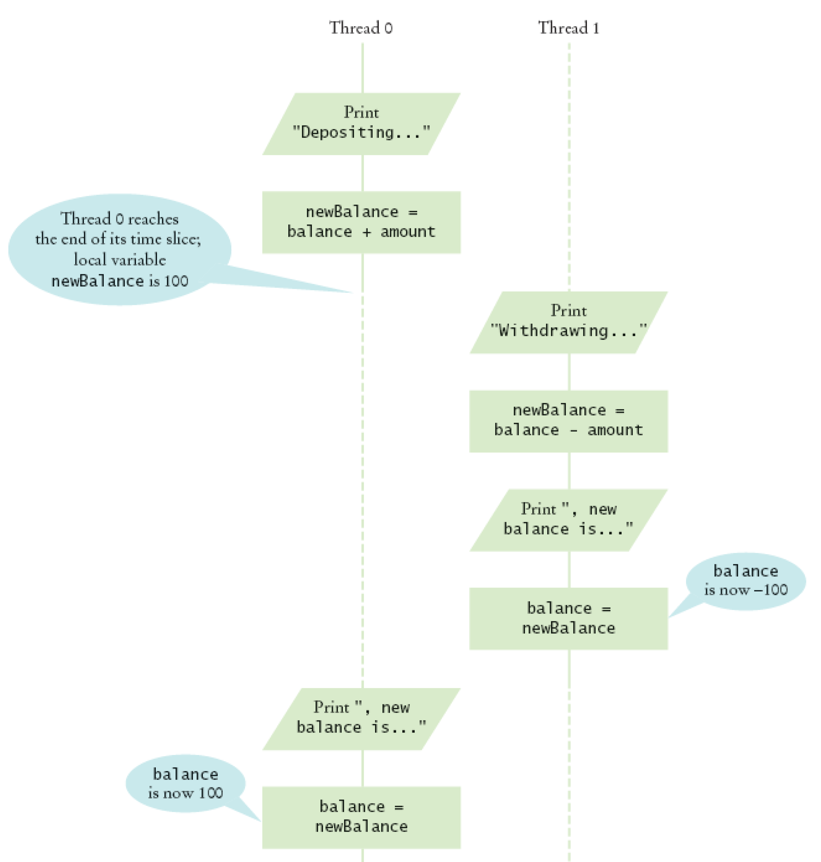
Corrupting the Contents of the balance Field
Corrupting the Contents of the balance Field

Slide 24
Race Conditions
Occurs if the effect of multiple threads on shared data depends on the order in which the threads are scheduled
It is possible for a thread to reach the end of its time slice in the middle of a statement
It may evaluate the right-hand side of an equation but not be able to store the result until its next turn
Continued

Slide 25
Race Condition
public void deposit(double amount)
{
balance = balance + amount;
System.out.print("Depositing " + amount + ",
new balance is " + balance);
}
Race condition can still occur:
balance = the right-hand-side value

Slide 26
Synchronizing Object Access
To solve problems such as the one just seen, use a lock object
A lock object is used to control threads that manipulate shared resources
Concerning the Lock interface and earlier facilities to achieve the same result:
  ReentrantLock: most commonly used lock class
  Locks are a feature of Java version 5.0
  Earlier versions of Java have a lower-level facility for thread synchronization

Slide 27
Synchronizing Object Access
Typically, a lock object is added to a class whose methods access shared resources, like this:
public class BankAccount
{
public BankAccount()
{
balanceChangeLock = new ReentrantLock();
. . .
}
. . .
private Lock balanceChangeLock;
}

Slide 28
Synchronizing Object Access
If code between calls to lock and unlock throws an exception, call to unlock never happens
To overcome this problem, place call to unlock into a finally clause.
Continued

Slide 29
Synchronizing Object Access
When a thread calls lock, it owns the lock until it calls unlock
A thread that calls lock while another thread owns the lock is temporarily deactivated
The Thread scheduler periodically reactivates each thread so it can try to acquire the lock
Eventually, the waiting thread can acquire the lock

Slide 30
Avoiding Deadlocks
A deadlock occurs if no thread can proceed because each thread is waiting for another to do some work first
How can we wait for the balance to grow in our example program?
We can't simply call sleep inside withdraw method; thread will block all other threads that want to use balanceChangeLock
In particular, no other thread can successfully execute deposit

Slide 31
Avoiding Deadlocks
Other threads will call deposit, but will be blocked until withdraw exits
But withdraw doesn't exit until it has funds available
DEADLOCK

Slide 32
Condition Objects
To overcome this problem, use a condition object
Condition objects allow a thread to temporarily release a lock, and to regain the lock at a later time
Each condition object belongs to a specific lock object

Slide 33
Condition Objects
It is customary to give the condition object a name that describes the condition to test
You need to implement an appropriate test
As long as the test is not fulfilled, call await on the condition object.

Slide 34
Condition Objects
Calling await()
  Makes current thread wait
  Allows another thread to acquire the lock object
To unblock, the thread with the lock must execute signalAll() on the same condition object
signalAll() unblocks all threads waiting on the condition
sufficientFundsCondition.signalAll();

Slide 35
Condition Objects
signal(): randomly picks just one thread
waiting on the object and unblocks it
signal() can be more efficient, but you need to know that every waiting thread can
proceed
Recommendation: always call signalAll()

Slide 36
Example Programs
Synchronized and unsynchronized versions of Bank Account:
\07Threads\unsynch\BankAccountThreadRunner.java
\07Threads\synch\BankAccountThreadRunner.java

Slide 37
An Application of Threads: Animation
Animations Show different objects moving or changing as time progresses
They are often achieved by launching one or more threads that compute how parts of the animation change
Simple animations might use a Timer class

Slide 38
An Application of Threads: Animation
More advanced animations are best implemented with threads
An algorithm animation helps visualize the steps in the algorithm
\07Threads\animation\
\07Threads\animationJavaFX

Slide 39
Algorithm Animation
The animation runs in a separate thread that periodically updates an image of the current state of the algorithm
It then pauses so the user can see the change
After a short time the algorithm thread wakes up and runs to the next point of interest
It updates the image again and pauses again

Slide 40
Selection Sort Algorithm Animation
Items in the algorithm's state (requiring synchronization):
  The array of values
  The size of the already sorted area
  The currently marked element
This state is accessed by two threads:
  One that sorts the array, and
  One that updates the window
To visualize the algorithm
  Show the sorted part of the array in a different color
  Mark the currently visited array element in red

Slide 41
Selection Sort Algorithm Animation: Implementation – Swing Version
Use a lock to synchronize access to the shared state
Add a JComponent (Swing) or Canvas (JavaFX) instance field to the algorithm class and augment the constructor to set it
That instance field is needed to
  Repaint the state of the sort, and
  Find out the dimensions of the component when drawing the algorithm state

Slide 42
Selection Sort Algorithm Animation: Implementation – JavaFX Version
Use a lock to synchronize access to the shared state
Use the Canvas instance field to the SelectionSortComponent class in the updated example. That instance field is needed to render the current state of the sort

Slide 43
Selection Sort Algorithm Animation: Implementation
Delay is proportional to the number of steps
involved
pause should be called at various places in
the algorithm

Slide 44
Selection Sort Algorithm Animation: Implementation
We add a draw() method to the SelectionSortComponent class
draw() draws the current state of the data
structure, highlighting items of special
interest
draw() is specific to the particular algorithm
In this case, draws the array elements as a
sequence of sticks in different colors
  The already sorted portion is blue
  The marked position is red
  The remainder is black

Slide 45
Wrapup: Extending class Thread
Simple example of a class that extends Thread.
Starts two Thread instances that do a fixed amount of work
\sourceCode\07Threads\ExtendThreadDemo.java

